Slide 1
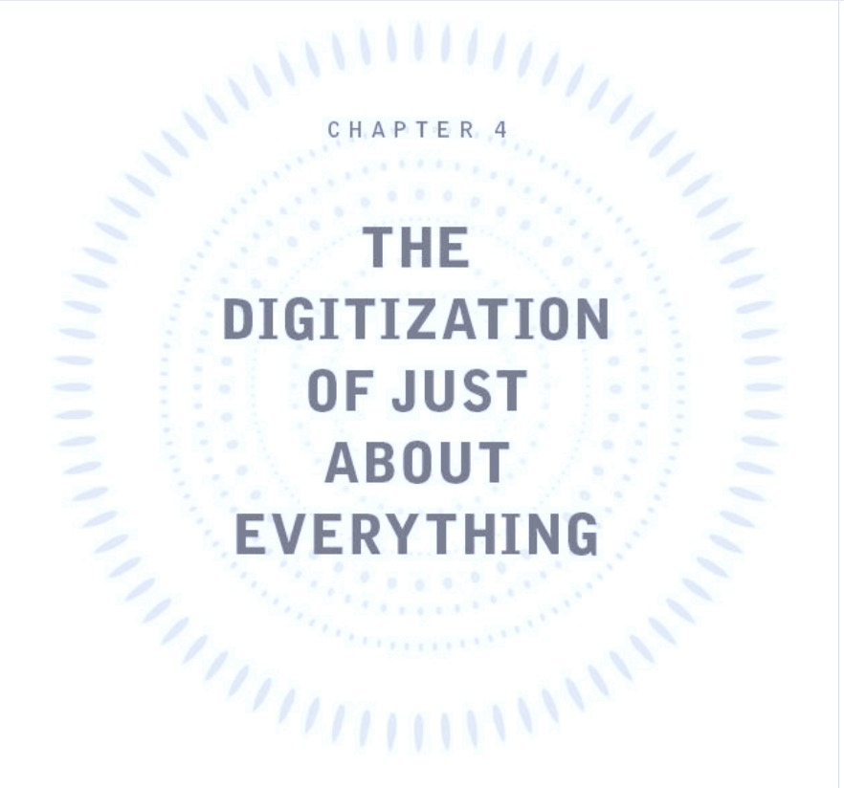

Slide 2
-Lord Kelvin
“When you can measure what you are speaking about, and express it in numbers, you know something about it; but when you cannot express it in numbers, your knowledge is of a meagre and unsatisfactory kind.”

Slide 3
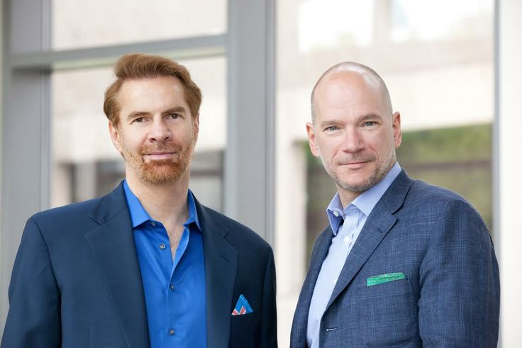
Book:
The Second Machine Age
Authors:
Erik Brynjolfsson
Andrew McAfee
Revelation of the technological forces driving the reinvention of today’s economy
Discovering a path towards future prosperity
Bringing change in how we think about issues of technological, societal and economic progress
3 Main Forces:
Exponential technological progress
Digitization
Style of Innovation

Slide 4
THE CHAPTER
EXPONENTIAL IMPROVEMENT IN COMPUTER GEAR:
Powerful and cheap devices like smartphones
Array of processors, sensors and transmitters
DIGITIZATION:
The work of turning all kinds of information and media, text, sound, photos, video, data from instruments and sensors — into the ones and zeros, the native language of computers.
Allows exploitation of economic properties of digital information like
non-rivalry and
close to zero marginal cost of reproduction.

Slide 5
QUESTIONS…
What do you think are the benefits /disadvantages of apps that depend on network effect – like Waze mentioned in the chapter?
Digitization has introduced us to the concept of “costly to produce - cheap to reproduce.”
How do you think this concept has aided into the shift to the second machine age? Do you think it might have any adverse consequences? Why?
What would happen to the digital world if information were no longer costly to produce?
What are your opinions on the growth and popularity of user generated content on the Internet? How do you think it might affect the credibility of information sources?
As the authors mention at the end of the chapter, “style of innovation” is one of the three main forces shaping the second machine age. What is your opinion on this?

Slide 6
THANK YOU FOR PARTICIPATING!
Lastly,
Any interesting point you’d like to discuss from the reading ???

